Slide 1
Cost Benefit Analysis for Health Economics

Slide 2
What is Cost Benefit Analysis?
A systematic way of cataloguing benefits and costs of a proposal.
Costs and benefits are not for individuals, but for society as a whole.
In a cost benefit analysis the goal is to make an assessment that quantifies in monetary terms the value of all policy consequences to all members of society.

Slide 3
The net social benefit measures the value of the policy.
  Social Benefits – B
  Social Costs – C
  Net Social Benefits – NSB = B - C
This is the standard approach that is used when cost-benefit analysis is used to evaluate a policy or a project.
Our focus is not so much on projects, but policy initiatives in health care or public health

Slide 4
The Economic Perspective
Economists focus their attention the following questions:
  What are the costs and benefits to society of the proposed policy, law or public sector project?
  Once identified, how do we measure social costs and benefits; Especially “intangible items” like the quality of life or the value of a life
  If costs and benefits occur at different times, perhaps over decades, how do we compare them?

Slide 5
Measuring Costs and Benefits
Costs are measured as opportunity costs.
  Should reflect the resource costs to society.
Benefits can be often measured directly in markets
Sometimes benefits can be also be inferred from market behavior, even though they may not be directly observed.
  Those that are inferred and not directly observed are called shadow prices or values (e.g., the value of a life)

Slide 6
Many decisions can have important consequences that extend overtime.
Assume discount rate is given (reasonable values are discussed at the end of the lecture).
Our goal is to take these values from different periods and basically convert them into something that is measured in the same units
We do this by taking the present value

Slide 7
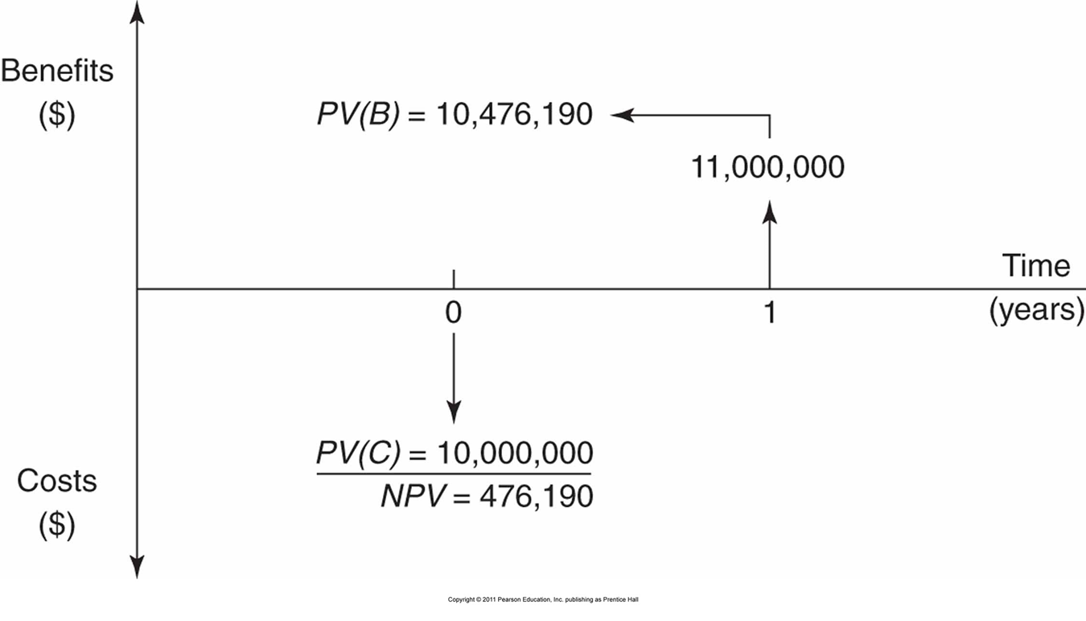
Example 1: Illustrating Present Value Analysis

Slide 8
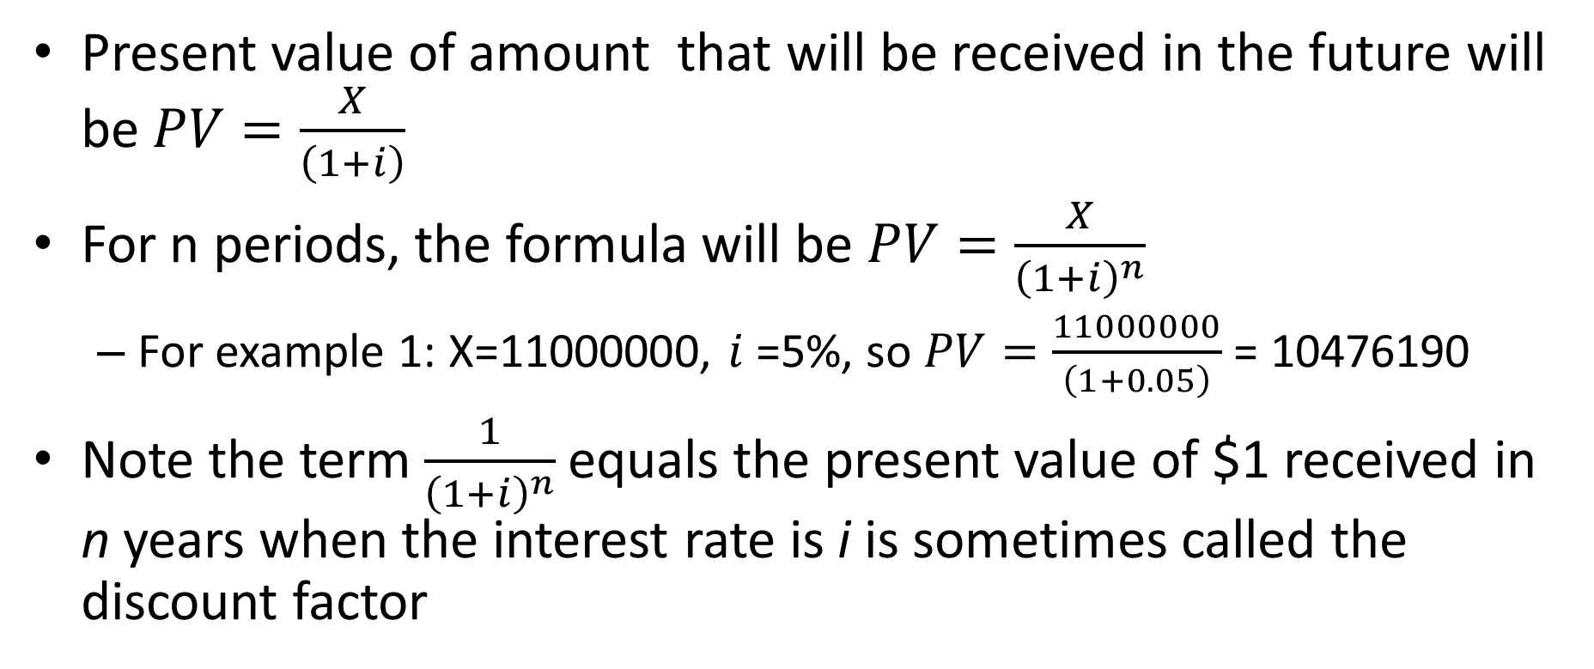
Present value of amount that will be received in the future will be $PV=\frac{X}{\left(1+i\right)}$
For n periods, the formula will be $PV=\frac{X}{{\left(1+i\right)}^{n}}$
  For example 1: X=11000000, $i$=5%, so $PV=\frac{11000000}{\left(1+0.05\right)}$ = 10476190
Note the term$\frac{1}{{\left(1+i\right)}^{n}}$equals the present value of $1 received in n years when the interest rate is i is sometimes called the discount factor

Slide 9
A Present Value Example:
Shohei Ohtani’s Contract
Shohei Ohtani (a baseball player who can both hit and pitch) signed a 10 year $700 million contract in the fall of 2023 with the Los Angeles Dodgers
The contract is structured as $2 million per year for 10 years (2024-2033) and then $68 million per year for (2034-2043)
If the discount rate is 3% what is the present value of the contract

Slide 10
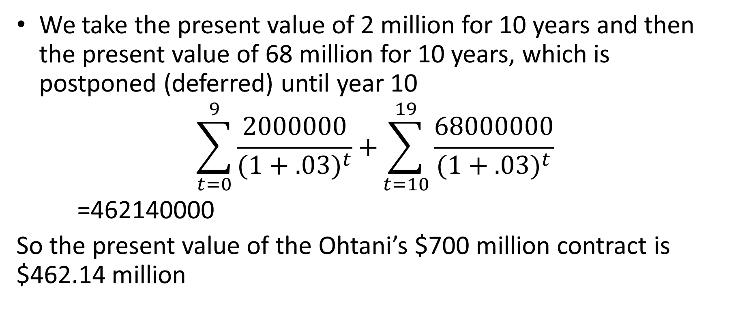
A Present Value Example:
Shohei Ohtani’s Contract
We take the present value of 2 million for 10 years and then the present value of 68 million for 10 years, which is postponed (deferred) until year 10
$$\sum_{t=0}^{9}{\frac{2000000}{{(1+.03)}^{t}}+}\sum_{t=10}^{19}{\frac{68000000}{{(1+.03)}^{t}}}$$
=462140000
So the present value of the Ohtani’s $700 million contract is $462.14 million

Slide 11
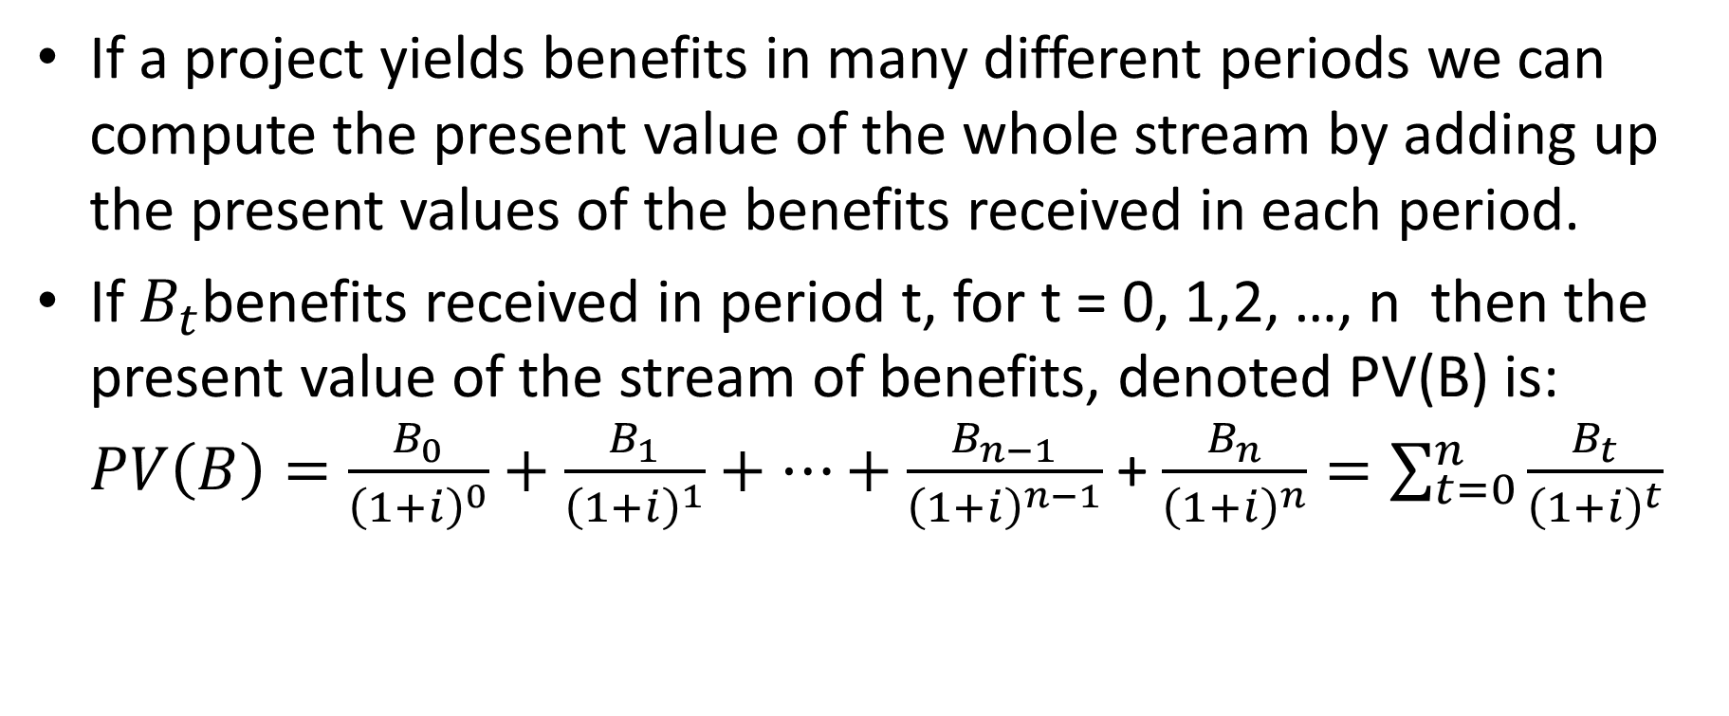
If a project yields benefits in many different periods we can compute the present value of the whole stream by adding up the present values of the benefits received in each period.
If $B_{t}$benefits received in period t, for t = 0, 1,2, …, n then the present value of the stream of benefits, denoted PV(B) is: $PV\left(B\right)=\frac{B_{0}}{{\left(1+i\right)}^{0}}+\frac{B_{1}}{{\left(1+i\right)}^{1}}+…+\frac{B_{n−1}}{{\left(1+i\right)}^{n−1}}$+ $\frac{B_{n}}{{\left(1+i\right)}^{n}}=\sum_{t=0}^{n}{\frac{B_{t}}{{\left(1+i\right)}^{t}}}$

Slide 12
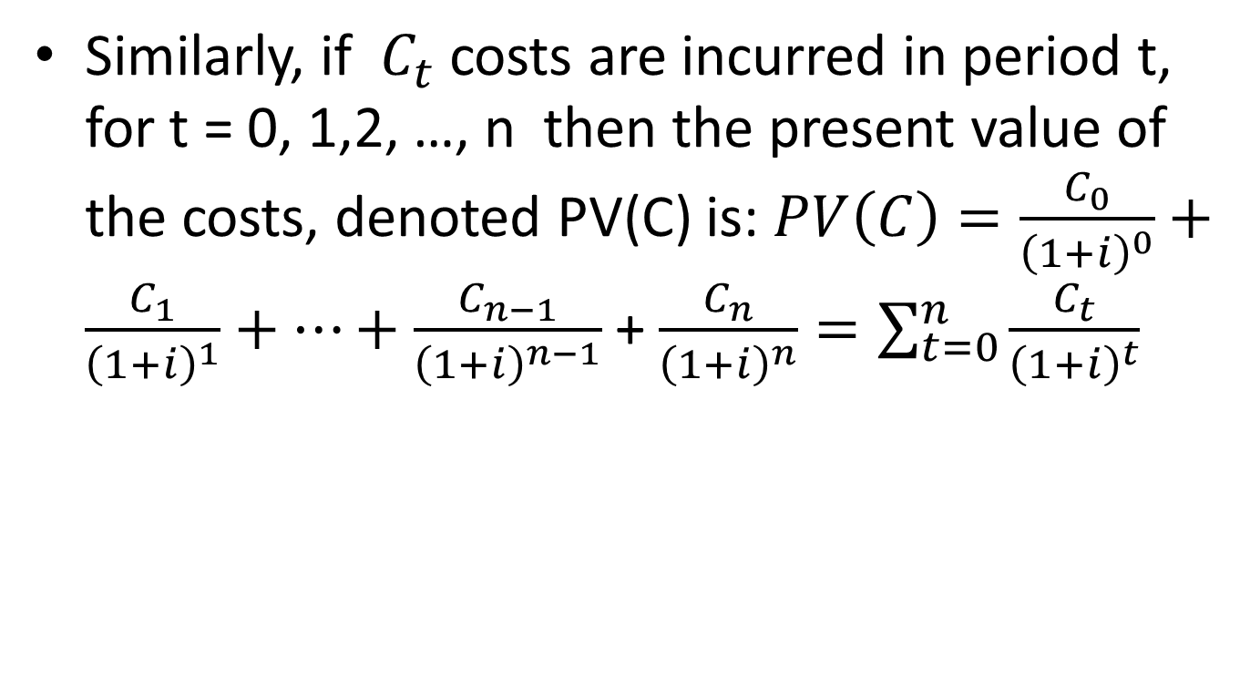
Similarly, if $C_{t}$ costs are incurred in period t, for t = 0, 1,2, …, n then the present value of the costs, denoted PV(C) is: $PV\left(C\right)=\frac{C_{0}}{{\left(1+i\right)}^{0}}+\frac{C_{1}}{{\left(1+i\right)}^{1}}+…+\frac{C_{n−1}}{{\left(1+i\right)}^{n−1}}$+ $\frac{C_{n}}{{\left(1+i\right)}^{n}}=\sum_{t=0}^{n}{\frac{C_{t}}{{\left(1+i\right)}^{t}}}$

Slide 13
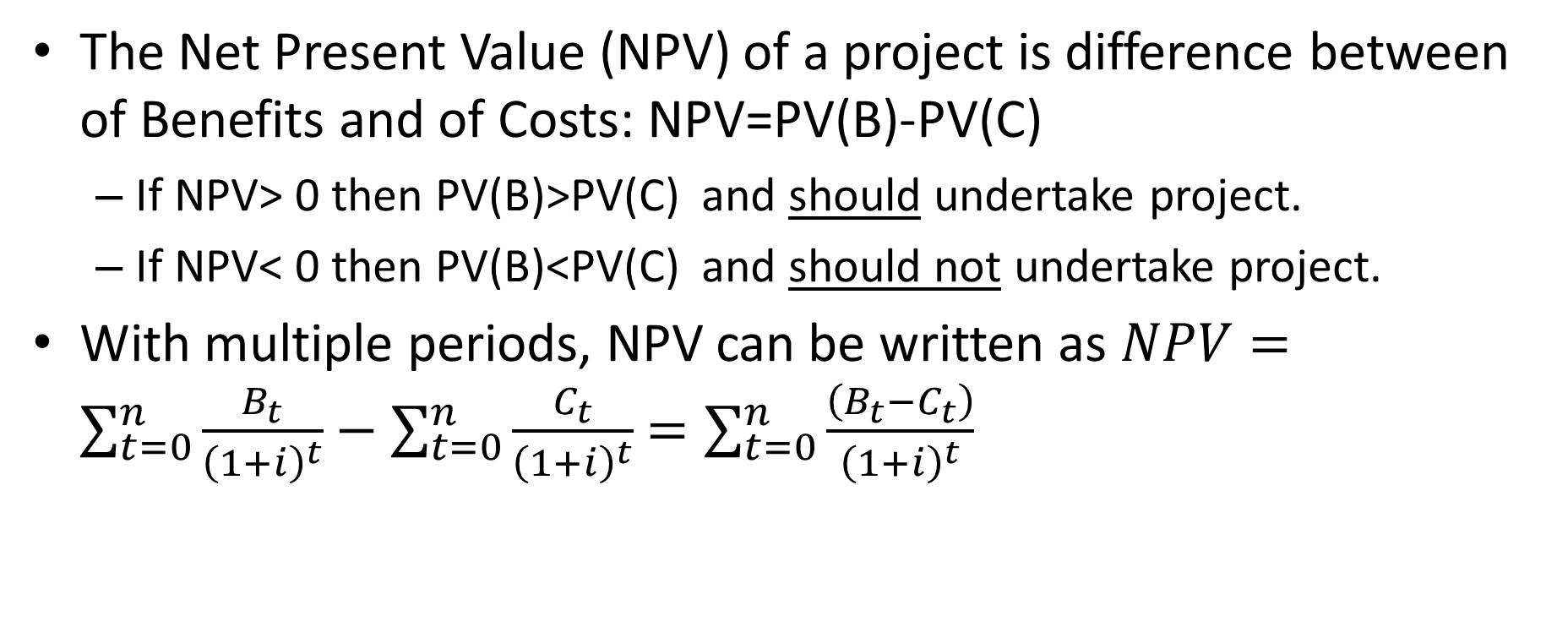
The Net Present Value (NPV) of a project is difference between of Benefits and of Costs: NPV=PV(B)-PV(C)
  If NPV> 0 then PV(B)>PV(C) and should undertake project.
  If NPV< 0 then PV(B)<PV(C) and should not undertake project.
With multiple periods, NPV can be written as $NPV=\sum_{t=0}^{n}{\frac{B_{t}}{{\left(1+i\right)}^{t}}}$ $−$ $\sum_{t=0}^{n}{\frac{C_{t}}{{\left(1+i\right)}^{t}}}$ $=\sum_{t=0}^{n}{\frac{\left(B_{t}−C_{t}\right)}{{\left(1+i\right)}^{t}}}$

Slide 14
Example for NPV
Suppose an organization purchases an information technology system, which it plans to use for five years. The benefits of the system are said to be $100,000 per annum (cost savings and benefits to users). The system costs $325,000 to purchase and setup and $20,000 to maintain. After five years the system will be dismantled and sold for $20000. Assume the discount rate is 7%.

Slide 15
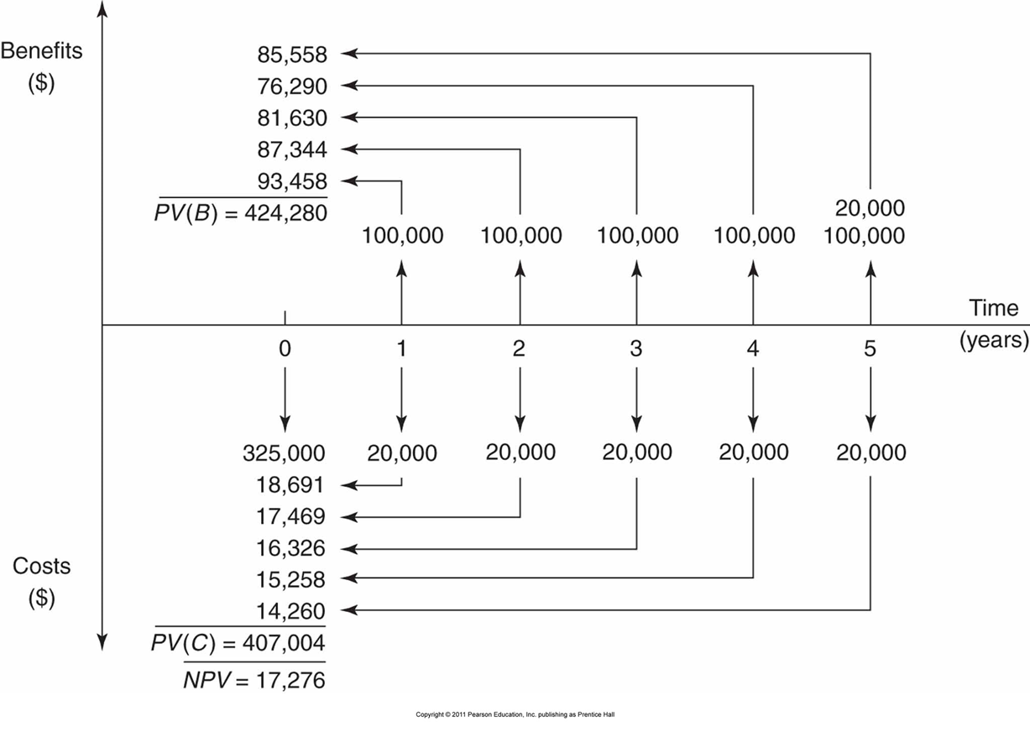
Diagram Illustrating Information Technology Example

Slide 16
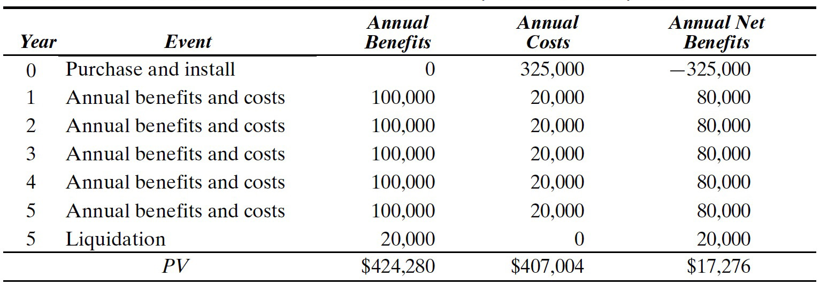
Table Presenting Benefits and Costs

Slide 17
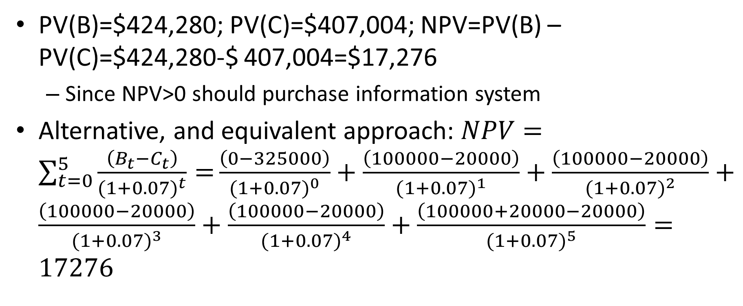
Computing the NPV
PV(B)=$424,280; PV(C)=$407,004; NPV=PV(B) – PV(C)=$424,280-$ 407,004=$17,276
  Since NPV>0 should purchase information system
Alternative, and equivalent approach: $NPV=\sum_{t=0}^{5}{\frac{\left(B_{t}−C_{t}\right)}{{(1+0.07)}^{t}}=}\frac{\left(0−325000\right)}{{(1+0.07)}^{0}}+\frac{\left(100000−20000\right)}{{(1+0.07)}^{1}}+\frac{\left(100000−20000\right)}{{(1+0.07)}^{2}}+\frac{\left(100000−20000\right)}{{(1+0.07)}^{3}}+\frac{\left(100000−20000\right)}{{(1+0.07)}^{4}}+\frac{\left(100000+20000−20000\right)}{{(1+0.07)}^{5}}=17276$

Slide 18
Measuring Costs and Benefits
To be able to conduct a cost benefit analysis we need values for the costs and benefits associated with a policy
Sometimes we’ll have these available and listed
When they aren’t available we can sometimes obtain the information from markets
  Using Supply and Demand Paradigm
  We measure costs as opportunity costs, i.e., real resource costs to economy not accounting costs

Slide 19
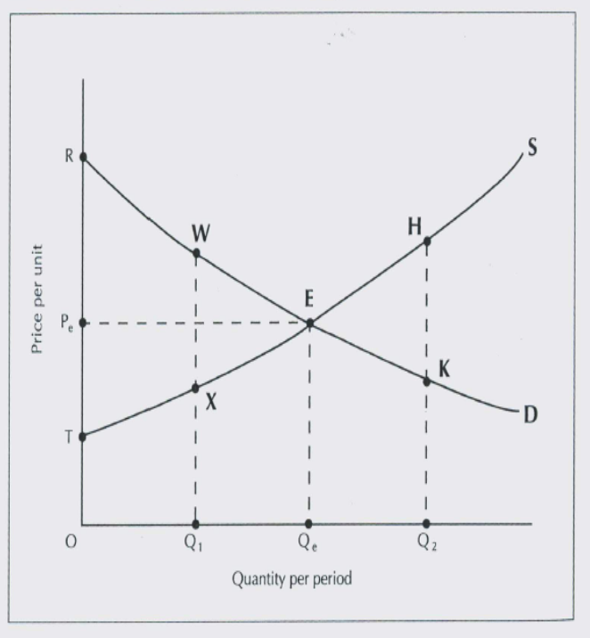
  Cost of producing units is measured by the area under the supply curve.
  The difference between the maximum consumers are willing to pay and minimum firms are willing to accept for producing than is given by RET, called the social surplus.

Slide 20
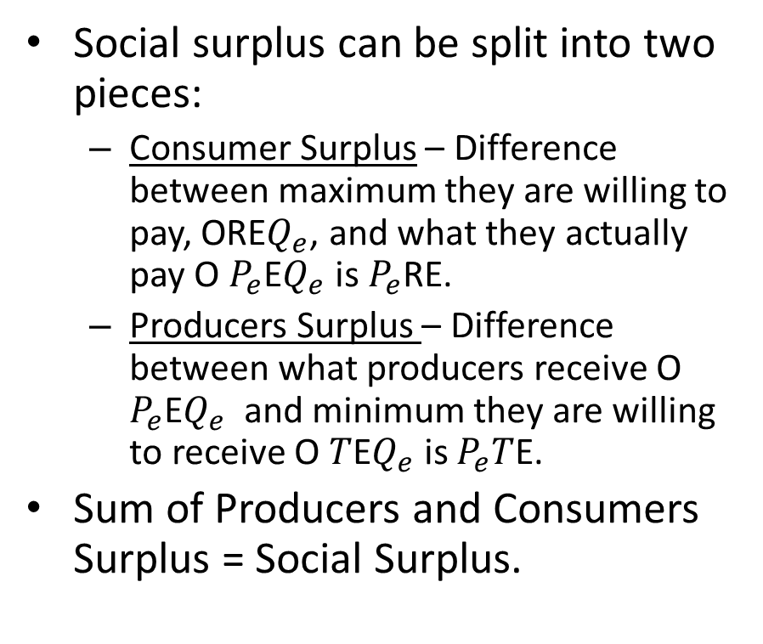
Social surplus can be split into two pieces:
  Consumer Surplus – Difference between maximum they are willing to pay, ORE$Q_{e}$, and what they actually pay O $P_{e}$E$Q_{e}$ is $P_{e}$RE.
  Producers Surplus – Difference between what producers receive O $P_{e}$E$Q_{e}$ and minimum they are willing to receive O $T$E$Q_{e}$ is $P_{e}T$E.
Sum of Producers and Consumers Surplus = Social Surplus.

Slide 21
Competitive markets maximize the sum of producer and consumer surpluses.
Competitive markets maximize social surplus because they accommodate all transactions that are mutually advantageous and reject any that are not.
In other words, competitive equilibrium is optimal.
Alternatively, equilibrium exhibits allocative efficiency or it is efficient. An allocation of resources is Pareto optimal (efficient) if it is impossible to find another allocation (level of output) such that at least one economic agent is made better off and no economic agent is made worse off.

Slide 22
Market Failures
Markets don’t always work properly.
  Might be monopolies who produce less than optimal amount of output.
  Might also be problems with information, insurers may not always be able to judge risks associated with someone who wants insurance.
  Externalties, which can create a difference between costs for society and private actors

Slide 23
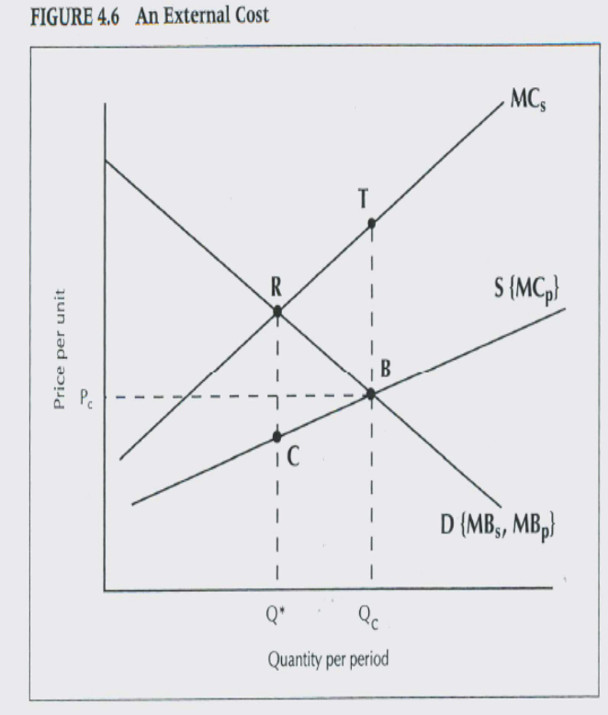
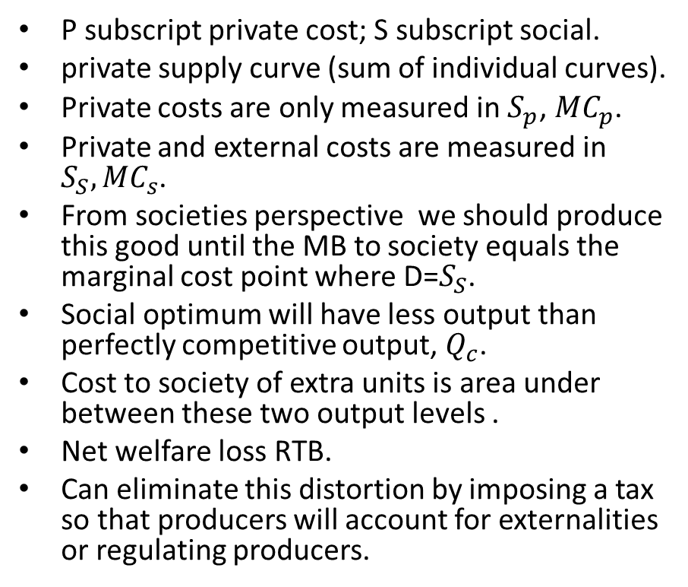
P subscript private cost; S subscript social.
private supply curve (sum of individual curves).
Private costs are only measured in $S_{p}$, ${MC}_{p}$.
Private and external costs are measured in $S_{S},{MC}_{s}$.
From societies perspective we should produce this good until the MB to society equals the marginal cost point where D=$S_{S}$.
Social optimum will have less output than perfectly competitive output, $Q_{c}$.
Cost to society of extra units is area under between these two output levels .
Net welfare loss RTB.
Can eliminate this distortion by imposing a tax so that producers will account for externalities or regulating producers.

Slide 24
Estimating Values not available in Markets
While markets often contain information on costs and benefits they do not always do so.
For example, how do we value a human life?
Values for a human life are not directly observable, but we can infer them from choices that individuals make about jobs

Slide 25
Statistical Value of a Life
  Rests on the following assumption:
    If you work a more dangerous job, then you will want a higher wage to compensate you for the dangers of worker (called a compensating differential), as risk increases so do wages
    If you assume that wages fully compensate workers for the hazards of working then it is possible to use the differences in wages between a “safe” job and a “risky” job;

Slide 26
Statistical Value of a Life
  A shadow price for the value of a life, can be computed using the differences between the safe and risky job.
  Example
    Job #1, the safe job, risk level 0.001
    Job # 2, the risky job, risk level 0.002
    Job #1 and #2 are same in every other respect except that the risky job pays $50/week than the safe job

Slide 27
Statistical Value of a Life
  This implies that a worker in the risky job is willing to accept an extra fatality risk of 0.001 for an extra $2,600 per year (52 weeks x $50 a week)
  Can extrapolate this figure

Slide 28
Statistical Value of a Life
Extra fatality risk | Extra salary required
0.001 | $2600 (1 x 2600)
0.002 | $5200 (2 x 2600)
0.003 | $7800 (3x 2600)
… | …
1.00 | $2,600,00 (1000x 2600)

Slide 29
Statistical Value of a Life
  Simple calculation:
  Value of Life= Requirement in Extra Salary/Extra Fatality Risk
  Value of Life=$2600/0.001=$2,600,000
  The statistical value of a life is a shadow value
  Generally, economists estimate the value of a life using regressions of wages on the probability of death as well as explanatory variables for worker and job characteristics

Slide 30
Statistical Value of a Life
A lot of estimates from the literature tend to be between $4 and $7 million.
The median estimate of a statistical value of a life is about $4.9 million
  So if we need to attribute a value to life in a cost benefit analysis $4.9 million is a good estimate.

Slide 31
Some Issues in Cost Benefit Analysis
There are some issues we need to be careful about when conducting a cost benefit analysis.
  They tend to inflate the values of costs or benefits so we need to be aware of them, as it can affect the conclusions we draw from a cost benefit analysis

Slide 32
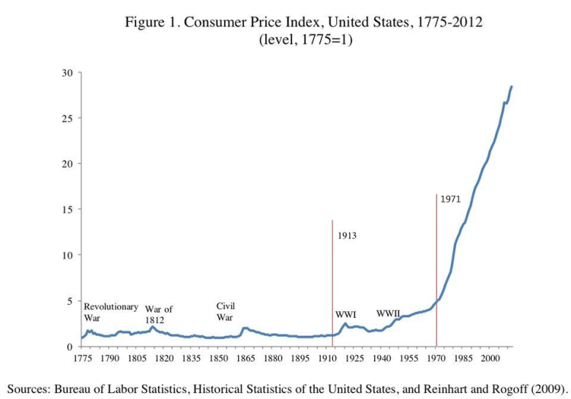
Inflation
Notes:
Note the relatively stability of prices up until 1913; also periods of rising inflation tend to be followed by periods of falling inflation. As inflation rises during WWII, like prior wars, but it doesn’t come after the war, it keeps going up. So by about 2000 the price level is 25X level in 1775, alternatively $1 from 1775 would only buy 4 cents ($0.04) of goods in 2000.

Slide 33
Inflation
A dollar today is not the same as a dollar 10 years from now
Always treat discount rate that is used in evaluation projects as “real”
Social discount rate is net of inflation
Nominal interest rate has two components a real rate of return and an adjustment for price level changes
In cost benefit analysis all benefits and costs are measured in real (constant) dollars and net present values are computed using a real discount rate

Slide 34
Direct and Secondary Effects
Easiest to illustrate these with an example.
Suppose a multipurpose dam is built which will provide flood protection, irrigation, recreational water use. Other potential impacts might include:
    Enhancing productivity of nearby agricultural land and increases farm profits.
    Increase in agricultural production would lead to increases in profits to firms that supply farmers.
    Increased recreational facilities might expand tourist industry in a region.
    Altered flow of water might cause more downstream dredging to be used more frequently than otherwise for navigation
    Altered flow of water will be conducive to fish breeding
    Increases in demand for construction workers will raise wages of other workers

Slide 35
Which Impacts should count?
  Only 1, 4, and 5 should be counted in a cost-benefit calculation. The rationale for this is discussed below.
Only impacts which result in changes to physical production should be counted.
Impacts that result in redistribution of income should be ignored.

Slide 36
Impacts to Count
Benefits
  Direct impacts
    (1) is an increase in farm output that is directly attributable to enhanced water supplies; it is a change in physical output should count (changes in profits or value of land induced by this shouldn’t)
    5) increases the productivity of downstream fishing industry and is an improvement in the real output of the economy.
Costs
  Direct Impacts
    4) Dredging the river is a real resource cost to the economy

Slide 37
Impacts to Count
All of the impacts on the previous slide are direct effects
Only direct effects should be counted in a cost benefit analysis

Slide 38
Impacts That Should Not Be Counted
Secondary impacts that are purely redistributive, or are accounted for somewhere else or are offset in the analysis should be excluded, i.e., (2), (3), (6)

Slide 39
Multiplier Effects
Multiplier effects should not be included in a cost benefit analysis
Why?
  Multiplier effects are basically like secondary effects except they are not specifically identified.
A multiplier is applied to the aggregate project expenditure to capture aggregate secondary effects
Almost all of the effects captured by the multiplier will be redistributive and not involve real resource costs.
As above only costs/benefits should be included in an evaluation

Slide 40
Discount Rate Rules of Thumb: Canada
The Federal Treasury Board Secretariat has recommended from about 1976 to the late-1990s, a discount rate of 10 percent, with a sensitivity analysis at 5 and 15 percent.
More recently, the Treasury Board Secretariat (recommends) a discount rate of about 7 percent, with a sensitivity analysis of 2 and 12 percent.
The Treasury Board recommends much lower discount rates (0 to 3 percent) for health or environmental cost benefit analysis.

